Slide 1


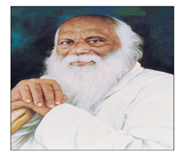

Rayat Shikshan Sanstha’s
“Karmaveer Bhaurao Patil Polytechnic, Satara”
Computer Engineering Department
Academic Year : 2022-23

Slide 2

JARVIS Voice Assistant

Slide 3
Submitted By: Nadaf Saad Asad Atharva Ajit Ombase Kshitij Manishkumar Jangam Aditya Nilesh Dhane
Under the guidance:
Prof. Bagwan S.N.
Computer Engineering Department

Slide 4
CONTENTS
Introduction | Literature Survey
Problem Statement | System Architecture
Abstract | E-R Diagram
Platform used | DFD’ Level 0,1,2
Technology Stack | UML Diagrams
Objective/Aim | Implementation
Conclusion and Future Scope | References

Slide 5
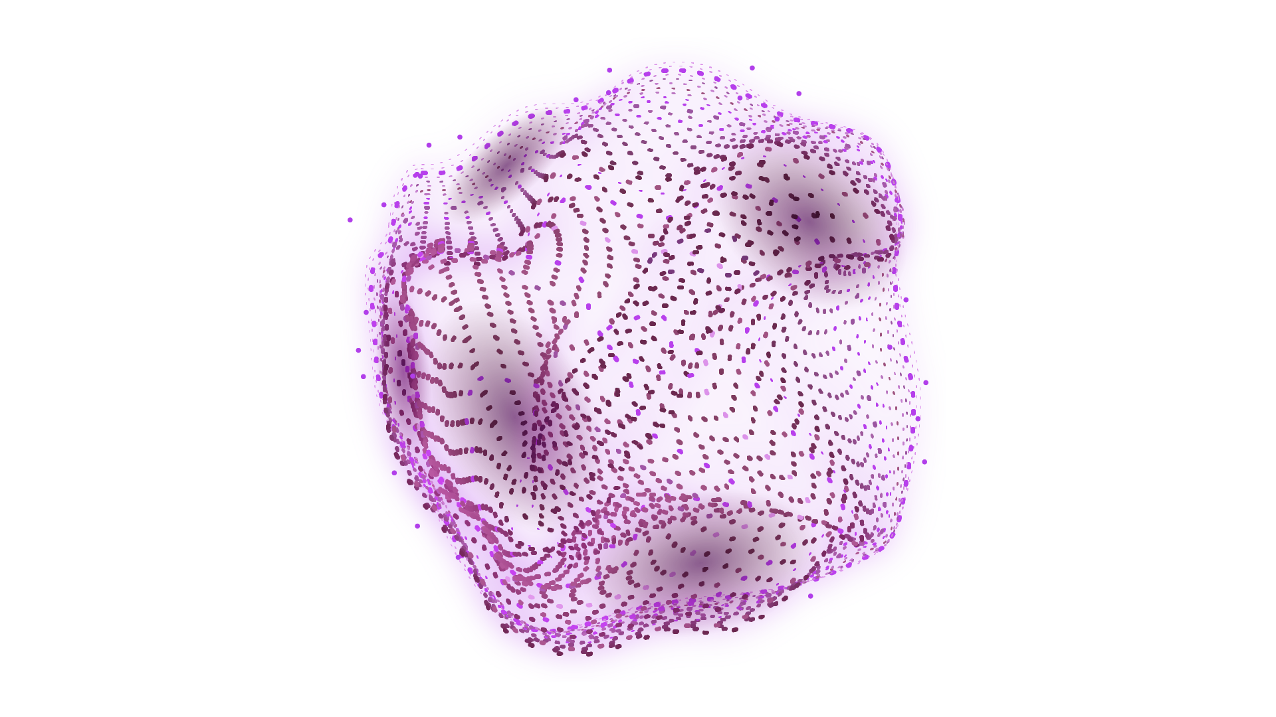

INTRODUCTION
Name Of Project : JARVIS Voice Assistant
Use :
Advantages :1 Saves time and efforts
Smooth Integration
Limitations : High Speed Internet is required
It Cannot work in noisy environment
Application :

Slide 6
PROBLEM STATEMENT
leverages computers and machines to mimic the problem–solving and decision–making capabilities of the human mind.
To gain knowledge in voice assistant.

Slide 7
ABSTRACT
JARVIS is a virtual embedded voice assistant that includes cutting-edge technology based on gTTS and Python in developing a personalized assistant. JARVIS integrates the functionality of AIML and, together with Google, the industry leader, a text-to-speech platform and thus male/female voices into the gTTS libraries powered by the Marvel world. This is often the result of adopting the dynamic base Pyttsx Pythons considered wise in contiguous phases of gTTS, facilitating the establishment of essentially fine-tuned dialogues between assistant management and users. It will help end users in their daily activities like general human speech, query search in Google, Bing, or Yahoo, video search, image retrieval, live weather, word meaning, and predict and remind users of scheduled events and tasks.

Slide 8
PLATFORM USED
Processor:
Hard Disk:
RAM:
32GB(recommended)
4GB(recommended)
Intel Core i5
Hardware:
Microphone

Slide 9

TECHNOLOGICAL STACK
SOFTWARE REQUIREMENT
Windows 7/10
Python IDE
Visual studio
Front End: python
Back End: MySQL

Slide 10
OBJECTIVE / AIM
The objective aim for Jarvis voice assistant can be defined as: To provide a seamless and efficient voice-controlled interface for users to perform various tasks, including but not limited to scheduling appointments, setting reminders, playing music, answering questions, controlling smart home devices, and providing personalized recommendations, in a natural and intuitive manner.

Slide 11
LITERATURE SURVEY
S. No |  | Name | Year | Author | Review
1. |  | Jarvis, Digital Life Assistant’ | 2013 | Khobragade S. | This paper explains how the author's project uses voice as a communication format, which is basically the Speech recognition application.There are two main basic concepts in speech technology: Synthesizer & recognizer. A speech synthesizer takes input and produces an audio stream as output,while speech recognition takes an audio stream as input and turns it into text transcription.
2. |  | ‘Virtual assistant for the visually impaired’ | 2020 | Iyer V.,Shah T.K. ,Sheth S.,Kailas D. | In this paper, the author explains how he built a software that provides a new dimension to access and provide commands to any website.
3. | AI Based Voice Assistant Using Python |  | 2019 | Shende D.,Umahiya R.,Raghorte M.,Bhisikar A.,Bhange A. | In this paper, the design and implementation of Digital Assistance is discussed. The project is built using open source software modules with PyCharm community backing which can accommodate any updates in the near future. The modular nature of this project makes it more flexible and easy to add additional features without disturbing current system functionalities.
4. | Research Desktop Assistant |  | 2022 | Dhanraj K.V.,Kriplani L. and Mahajan S. | A key objective of AI in this paper is to establish natural dialogue between humans and machines. Voice assistants are great innovations in artificial intelligence that can revolutionize how people live in a very positive way. Since voice assistants were introduced to smartphones, they have been widely accepted. Desktop voice assistants are programs that recognize human voices and

Slide 12
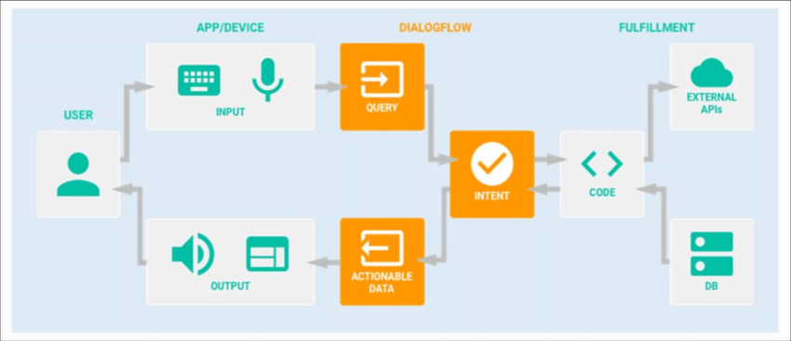
SYSTEM ARCHITECTURE

Slide 13
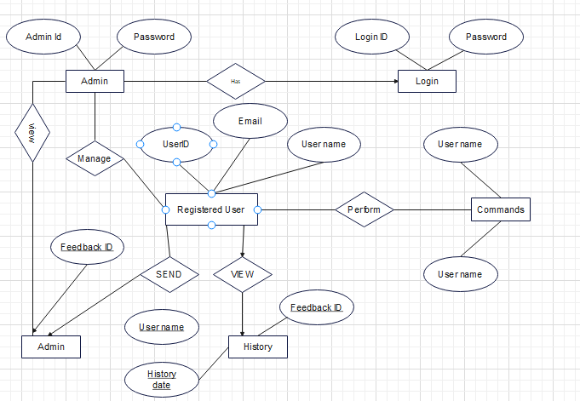
E-R DIAGRAM

Slide 14
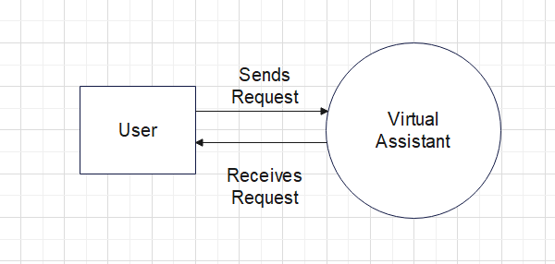
DFD LEVEL 0

Slide 15
DFD LEVEL 1

Slide 16
DFD LEVEL 2

Slide 17

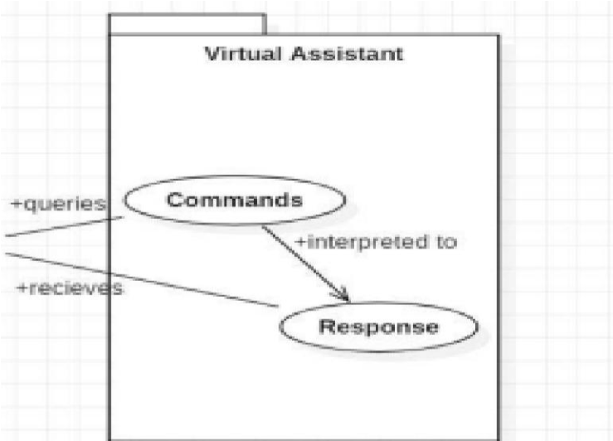
UML Diagrams
Figure 5:
Use Case Diagram

Slide 18
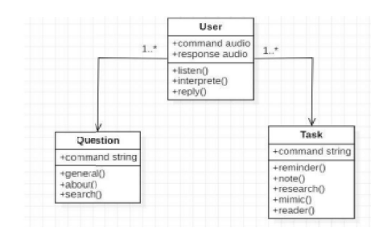
Class Diagram

Slide 19
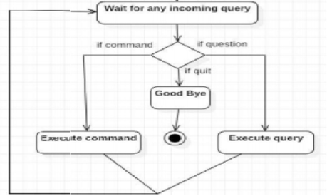
Activity Diagram

Slide 20
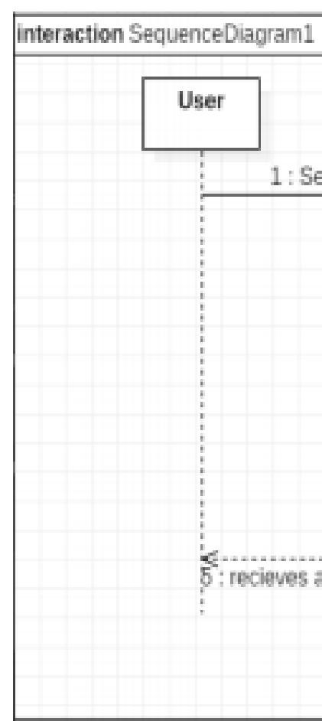
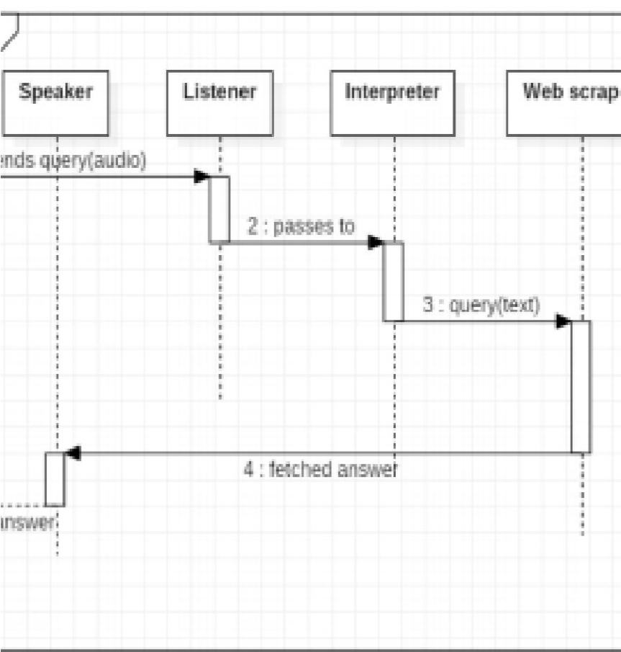
Sequence Diagram
A.
Sequence diagram for Query
-
Figure 6:
Sequence Diagram

Slide 21
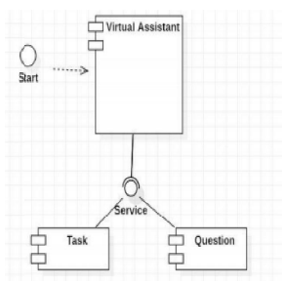
Component Diagram

Slide 22
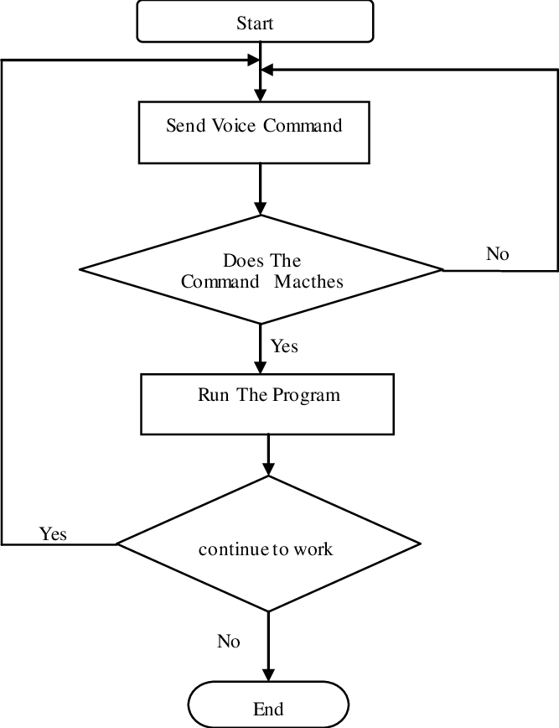
State Transition Diagram

Slide 23
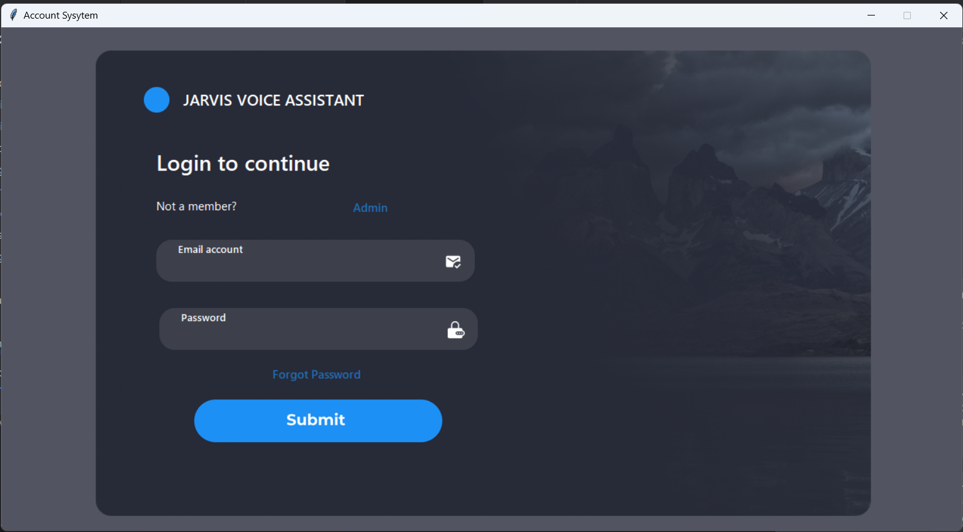
RESULT

Slide 24
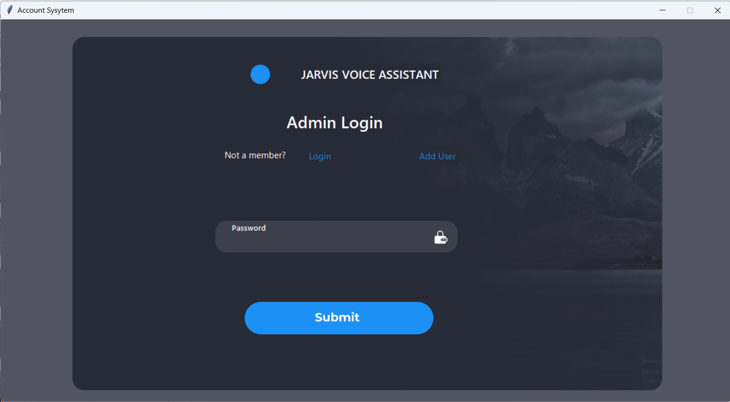

Slide 25
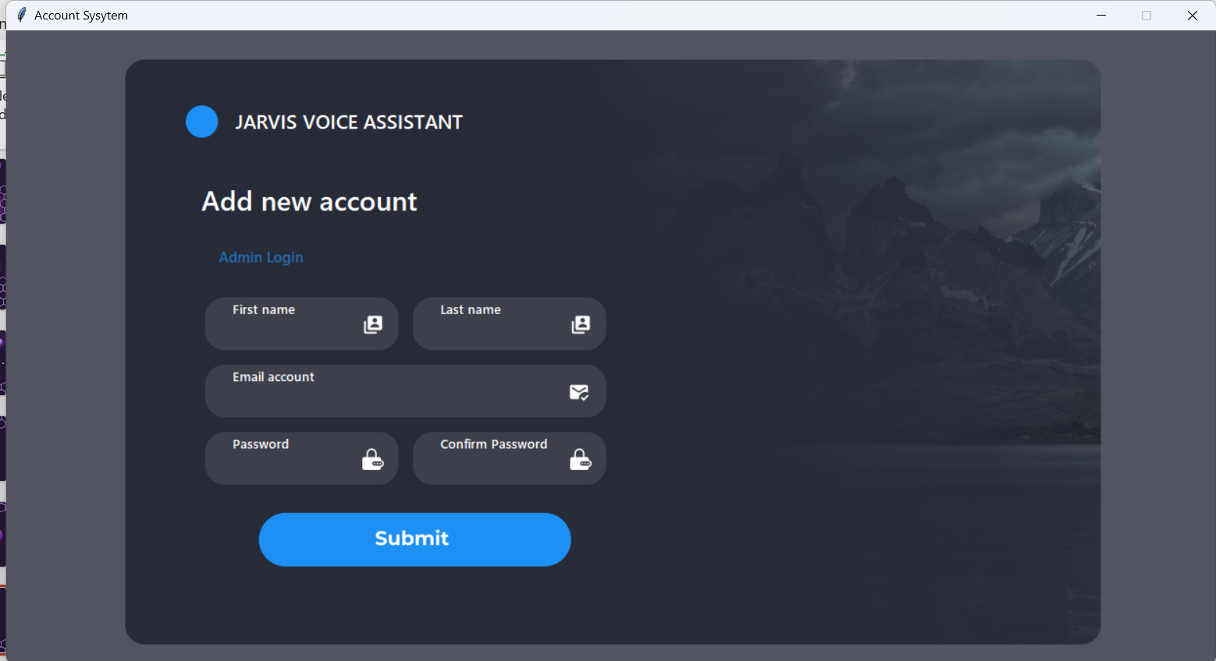

Slide 26
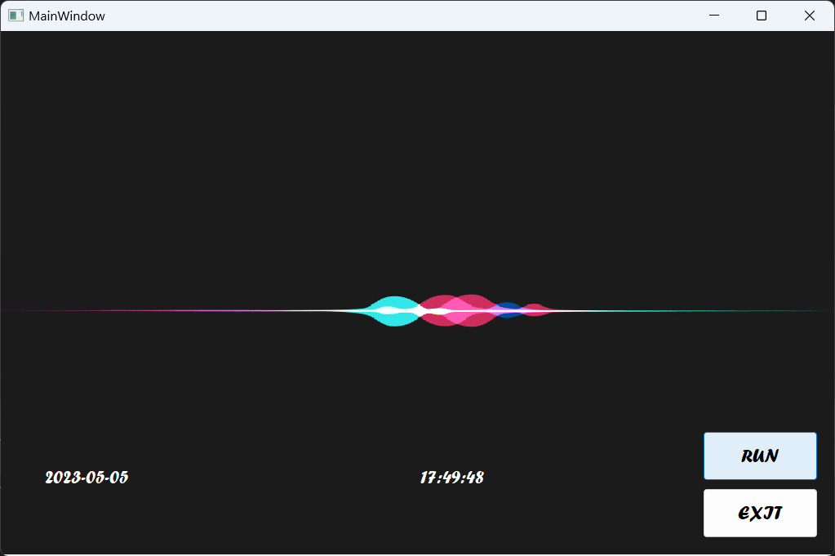

Slide 27
FUTURE SCOPE
The virtual assistants which are currently available are fast and responsive but we still have to go a long way. The understanding and reliability of the current systems need to be improved a lot. The assistants available nowadays are still not reliable in critical scenarios. The future of these assistants will have the virtual assistants incorporated with Artificial Intelligence which includes Machine Learning, Neural Networks, etc. and IoT. With the incorporation of these technologies, we will be able to achieve new heights. What the virtual assistants can achieve is much beyond what we have achieved till now. Most of us have seen Jarvis, that is a virtual assistant developed by iron man which is although fictional but this has set new standards of what we can achieve using voice-activated virtual assistants.

Slide 28
CONCLUSION
Voice Assistant helps the users with hand free voice control of their system. Speech recognition is the technology which provides a new way of human interaction with machines. It is very much helpful to the physically challenged people. This helps the visually impaired to have access to the most important features of the system enhancing the quality of the system by making use of the different custom layouts and using text to speech. It not only works on human commands but also gives responses to the user on the foundation of a query being asked or the words spoken by the user such as opening tasks and operations. It is addressing the user the way the user feels more enjoyable and feels free to interact with the voice assistant. The entire system works on verbal input rather than text.

Slide 29
REFERENCES
www.stackoverflow.com
www.pythonprogramming.net
www.codecademy.com
www.tutorialspoint.com
www.python.org
Python Programming - Kiran Gurbani
Learning Python - Mark Lutz [9] CS Dojo [10] eureka!
Codewithharry
Designing Personal Assistant Software for Task Management using Semantic Web Technologies and Knowledge Databases, PurushothamBotla
Python code for Artificial Intelligence: Foundations of Computational Agents, David L. Poole and Alan K. Mackwort

Slide 30
THANKS!

